Slide 1

SASA
March GBM!!

Slide 2
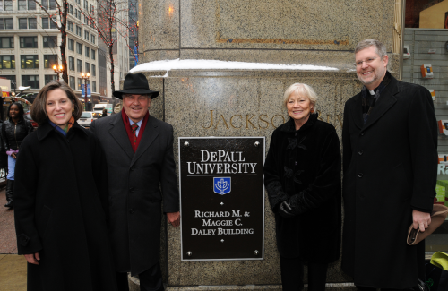

Current Event
DePaul University first to name a Chicago building after Mayor Richard M. Daley & wife
  Undergraduate and law education from DePaul
DePaul has made ACT or SAT scores optional for freshman admission in 2012
More info on DePaul’s website

Slide 3
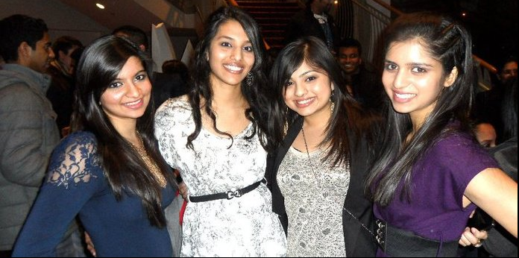
Membership
Membership fee is $20
Receive a free SASA t-shirt
Discount to certain events!
Must be a member to be in the show
See Angeline or Sabina to become a member today!

Slide 4
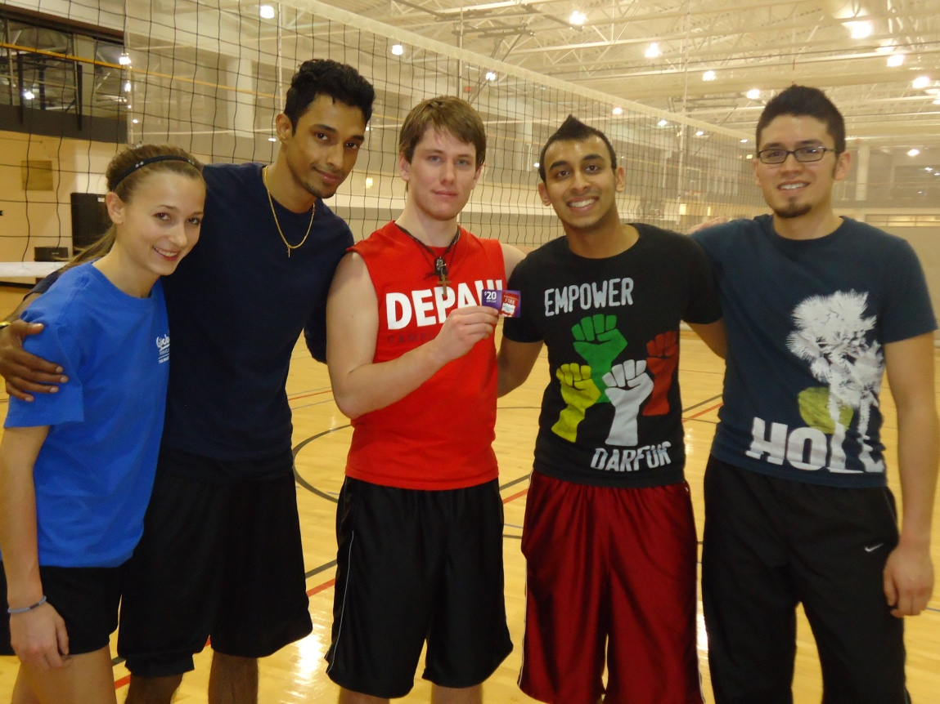
Volleyball Tournament
Thanks to all those who came out!
Hope everyone had fun!
Congrats to Team Bissell Boys!
Notes:
Wining Team Picture

Slide 5

Drug and Alcohol Abuse Event
Thanks to everyone who attended
Very informative event and guest speakers
There are pamphlets and cards from the different facilities available in the back

Slide 6
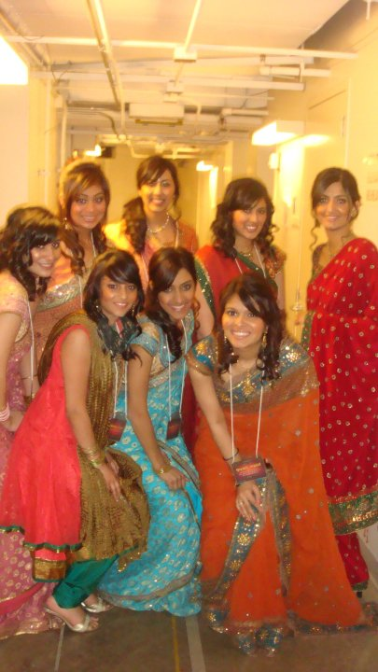
Fashion Show
When: March 1st
  TOMORROW!
Time: 9:30pm
Where: Room 325
Fashion show coordinators: Sahrish Qureshi and Monica Patel
Ladies: Bring heels!
Will be evaluated at next practice

Slide 7



Theme for The Show is…
Bollywood Meets Hollywood
: Where Stars Align!

Slide 8
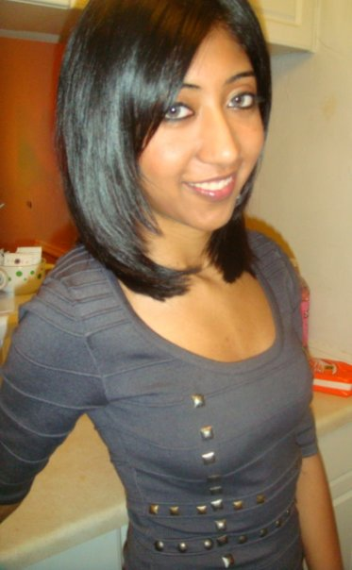

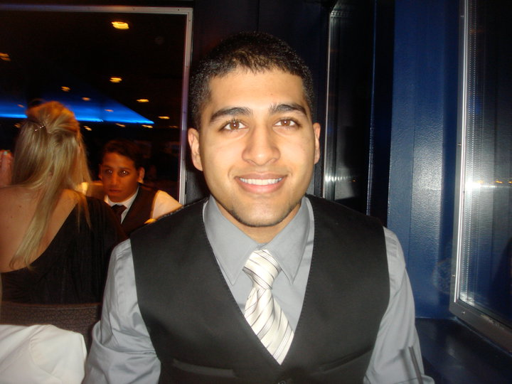
Emcees
Working on skit and video ideas!
If your group wants to talk about your skit be sure to contact Asad, Sarah, or Sharup
Notes:
Does anyone have a picture of Sharup by any chance?

Slide 9
75% Evaluations
Dates: March 1st Room 314AB, 2nd Room 220
Must be 75% of your act, and you must bring your mix with you
Will have 20 min time slots to setup and perform for Show Chairs
Need sample of all outfits boys/girls will wear
Pictures will be taken for Show Booklet

Slide 10
75% Evaluations con’t
Dates: March 1st Room 314AB, 2nd Room 220
All tech sheets will be collected directly after GBM
  Any ideas on spotlights, colored lights, fog machine, ect. Let us know!
Attendance is mandatory
Although no more acts will be cut, bring your A game!

Slide 11
Show Rules
NO ALCOHOL!
  If we catch you drinking at ANY SASA event or meeting you WILL be kicked out of the show!
Plan Ahead
  You will be aware ahead of time of all meetings’ dates and times; therefore, plan accordingly (re: school)
Strike Policy
  If you miss more than 1 GBM you have to attend at least one of two show committees in April
    If you are going to miss a meeting, please let the show coordinators know at least 2 days before the meeting.
  **This policy applies to act coordinator meetings!
Please Be Respectful during Rehearsals and Meetings

Slide 12
Show details
SASA Show shirts pending
  More info will be given soon
Buses
  Available on Friday April 15th – Dress Rehearsal
  Also available on day of show for students/faculty coming from Lincoln Park
Ticket Sales
  Will be announced soon
Want to get involved?
  Contact Show chairs after the meeting

Slide 13
Important Dates
Show Committees – April 6th & April 13th
75% evaluations - March 1^{st #314AB}, 2^{nd #220}
100% evaluations - Sun April 3rd in MPR 2pm
April GBM - April 11th
Show Rehearsal - Friday April 15th @ NSCPA
Show Date - Saturday, April 16th @ NSCPA
These dates are MANDATORY for all participants!

Slide 14
Act Coordinator Meetings
Held after every GBM – will be 4 of them in total
Length shall be roughly 10 mins
If you cannot attend then a representative from your group must go in your place
Will be held after GBM today

Slide 15
Room Reservations
Email Priyal Patel at dpusasa.secretary@gmail.com
Student Center, SAC and Munroe Rooms
Can't use Ray rooms under SASA's name
Policy:
  Book room at least 2 weeks prior
  Cancel at least 10 days prior
  Don't show up once = no longer allowed to use rooms
* ROOMS FILL UP FAST!!!

Slide 16

Show Booklets
Interested in purchasing a space in the show booklet this year?
Space for advertisements for local businesses of friends, families, and all members of the South Asian community
Documents can be found on the DePaul SASA Website
  Checks Only
  Must send you the image
  Forward them to Palak with all docs
    dpusasa.execmarketer02@gmail.com

Slide 17

Show DVD’s
Didn’t get a show DVD yet?
Full length DVD including Videos, MC Skits, and Acts
You can purchase one after the meeting from Sabina Samra for only $5!

Slide 18
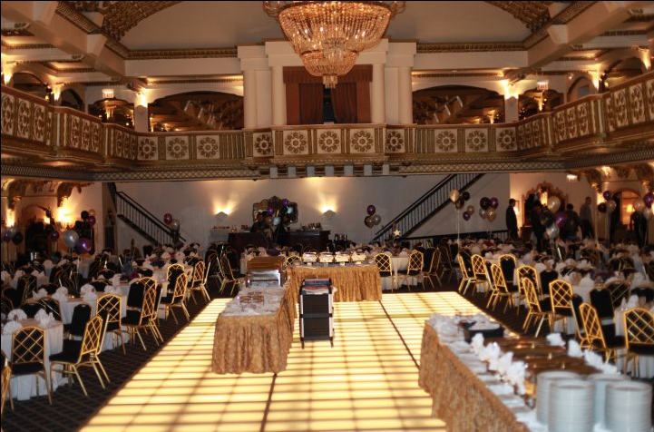
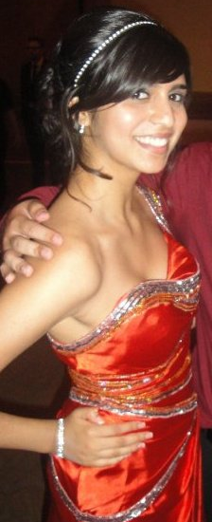
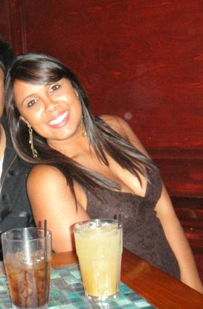
Formal
Save the Date:
  Friday, May 6th!!!
Collaborating with UIC ISA
More info about Formal in upcoming weeks!
Formal Chairs!
  Rina Soni
  Shreena Shah

Slide 19
www.Depaulsasa.yolasite.com
Join our Facebook
Group today!
DePaul SOUTH ASIAN
STUDENTS ASSOCIATION

